Slide 1
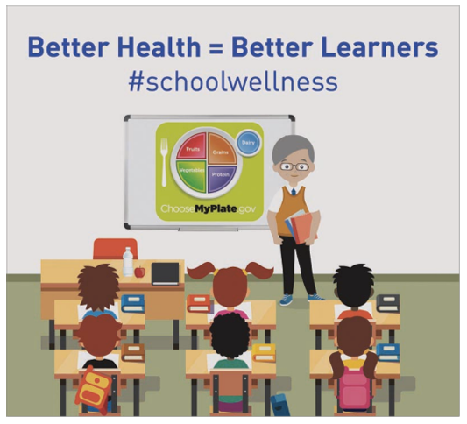
Wellness Policy Committee
District Office
April 18, 2024

Slide 2
Big Spring Wellness committees
BSSD Wellness
Most visible
Mrs. Header run
Wellness Committee
CBA reps and Administration
Discuss Health Care Concerns and Changes
Wellness Policy Committee

Slide 3
Wellness Policy: Purpose
Physical well-being
Growth
Development
Readiness to learn

Slide 4
Why do we have a wellness policy?
A wellness policy helps create a healthy school environment. Our wellness policy includes four important components:
Wellness Policy Committee
Nutrition Education
Nutrition Promotion
Physical Activity
Compliance – Policy 246 and Healthy, Hunger Free Kids Act (HHFKA)
If policy and rules are not followed, District is at risk of funding being delayed or forfeited

Slide 5
Wellness policy committee
School Board Member
District Administrator
District Food Service Representative
Student
Parent/Guardian
School Health Professional
Physical Education Teacher
Member of the Public

Slide 6
Wellness policy Committee
Communicates and advices on student health issues
Responsible for development, implementing and periodically reviewing wellness policy
Reviews and considers evidence-based strategies and techniques in establishing goals for:
Nutrition education and promotion
Physical activity
Other school-based activities that promote student wellness

Slide 7
National School Lunch Program (NSLP)
President Harry S. Truman signed the National School Lunch Act on June 4, 1946.
The legislation came in response to claims that many American men had been rejected for World War II military service because of diet-related health problems. The federally assisted meal program was established as “a measure of national security, to safeguard the health and well-being of the Nation’s children and to encourage the domestic consumption of nutritious agricultural commodities.”
The National School Lunch Act has since been amended numerous times.

Slide 8
What is Offer vs Serve?
Allows students to decline a certain number of food items
Minimizes food waste and encourages schools to offer more food choices
Is mandatory for grades 9-12
Optional for all other grade levels

Slide 9
Lunch Regulations
All 5 components must be offered
Protein
Grain
Veggie
Fruit
Milk
Students must choose 3 of the 5, with ONE being a fruit or vegetable
Serving sizes must be equal to the minimum requirement
Students must take a full serving to count toward a reimbursable meal
Each meal component must be priced as a unit
Students have the option to refuse items, schools cannot require students to take any particular item

Slide 10
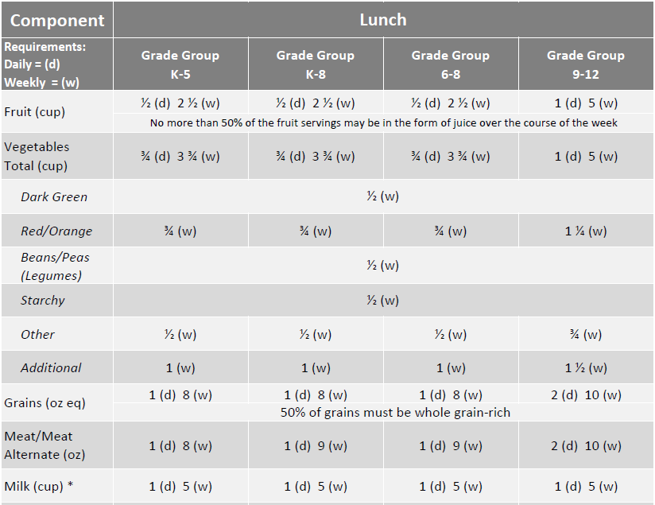
USDA Lunch Meal Pattern

Slide 11
National Breakfast Program (SBP)
On October 11, 1966, President Lyndon B. Johnson signed the Child Nutrition Act of 1966.
The SBP is a federally assisted meal program that provides nutritionally balanced, low-cost or free breakfasts to children in public and nonprofit private schools and residential child care institutions.
President Johnson remarked during the signing of the Child Nutrition Act of 1966, “good nutrition is essential to good learning.” Appropriately, this Act was signed during National School Lunch Week. The SBP is celebrated annually during National School Breakfast Week.

Slide 12
Breakfast Regulations
All 4 items must be offered
2oz. grain
2 ½ cup servings of fruits or vegetables (2 most be offered)
1 cup of milk
Protein may be substituted for 1oz. of grain
Students must choose 3 items, with ONE being a ½ cup of fruit or vegetable
Serving sizes must be equal to the minimum requirement
Students must take a full serving to count toward a reimbursable meal
Each meal component must be priced as a unit
Students have the option to refuse items, schools cannot require students to take any particular item

Slide 13
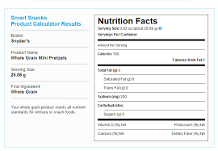
Smart Snacks
Smart Snack Standards is a Federal requirement for all foods sold outside of the national School Lunch Program and School Breakfast Program
Foods and beverages sold at school that need to meet the requirement
Any school food or beverage sold to students during the school day
A la carte items, extra meal components and vending
Food and beverage fundraisers, unless these items are not intended for consumption during school
School day is defined as the midnight before to 30 minutes after the end of the school day
Smart Snack Calculator

Slide 14
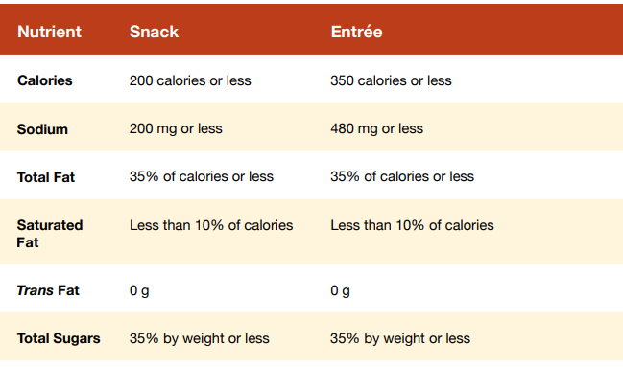
Smart Snacks Standards for Foods
To qualify as a Smart Snack, a snack or entrée must first meet the general nutrition standards:
Be a grain product that contains 50 percent or more whole grains by weight (have a whole grain as the first ingredient); or
Have as the first ingredient a fruit, a vegetable, a dairy food, or a protein food; or
Be a combination food that contains at least ¼ cup of fruit and/or vegetable (for example, ¼ cup of raisins with enriched pretzels); and
The food must meet the nutrient standards for calories, sodium, fats, and total sugars.

Slide 15
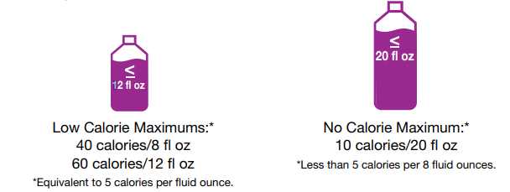
Smart Snacks Standards for Beverages
To qualify as a Smart Snack, a beverage must first meet the general nutrition standards:
Unflavored or flavored fat-free milk, unflavored low-fat milk, and milk
100% fruit or vegetable juice, with or without carbonation
100% fruit or vegetable juice diluted with water, with or without carbonation, and with no added sweeteners
Low- and no-calorie beverages, with or without caffeine and/or carbonation; calorie-free, flavored water (high school only)

Slide 16
State Audits
Every three years
Protect the regulations
Audit is both onsite and offsite
Forfeit of reimbursement for penalties not following offer vs serve

Slide 17
handouts
School Wellness Committee (SWC) Roles and Responsibilities
School Wellness Policy
Wellness Policy Assessment Tool
Completed June 26, 2023 – Needs to be reviewed every three years
Missing – GOALS!

Slide 18
Wellness goals
NUTRITION EDUCATION
NUTRITION PROMOTION
PHYSCIAL ACTIVITY
OTHER SCHOOL-BASED WELLNESS ACTIVITIES

Slide 19
Next Meeting
Review and Give Feedback – Policy and Wellness Assessment Tool and Report
Review and start thinking – Goals
September or October
Assigned groups to develop particular goals

